Slide 1
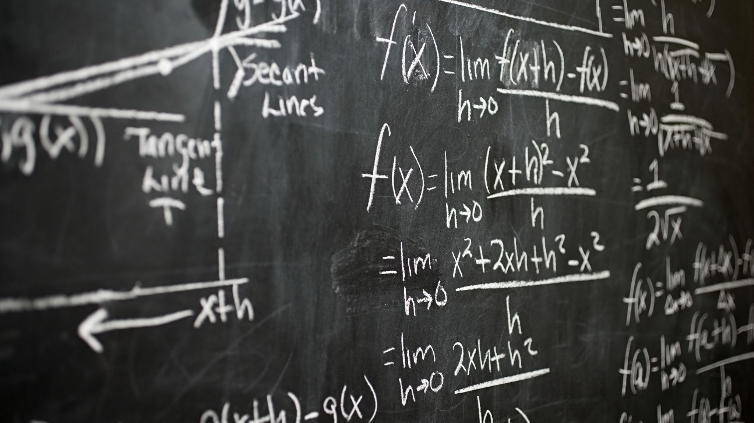
Natural Language Inference
Team – 21

Slide 2

Team Information
Team Members:
Harsha (2019101040)
Trinadh (2019101043)
Sri Ram (2019101032)
Team Number: 21

Slide 3
Contents
Problem Statement
Existing Datasets
LSTM based solution.
Tranformer Based solutions.
BERT
SpanBERT

Slide 4

Contents (contin)
Document NLI - Contract NLI
Difficulties with existing models.
Span NLI BERT
Results Found
Challenges Faced
Future Work

Slide 5

Problem Statement

Slide 6

Problem Statement
Consider the setting where we have two sentences S1, S2.
Now imagine you want to know how these are related. (Contradictory, Not related, Entailed etc).
Why this is important?

Slide 7
Problem Statement
Consider the setting where we have two sentences S1, S2.
Now imagine you want to know how these are related. (Contradictory, Not related, Entailed etc).
Why this is important?
Contract Reviews

Slide 8
Existing Dataset
SNLI (Stanford Natural Language Inference) Contains 570,000 human-written English sentence pairs manually labeled for balanced classification with the labels entailment, contradiction, and neutral.
MNLI (Multi-Genre Natural Language Inference) is an extension of the SNLI dataset, containing 433,000 sentence pairs annotated with textual entailment information. The main difference between SNLI and MNLI is that MNLI covers a broader range of text genres and more complex linguistic phenomena, making it more challenging for NLP models.

Slide 9
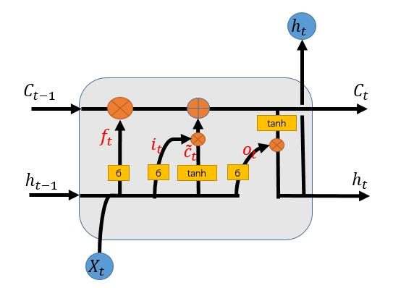
LSTM
This Photo by Unknown author is licensed under CC BY-SA.

Slide 10
General Idea
Get useful information from premise (sentence1), hypothesis (sentence2).
Use both these compact information to know how they are related.

Slide 11
How are we using LSTM
We will embed the sentences using LSTM.
We will pass these embeddings to series of Fully connected Layers.
Finally we apply activation function to get probabilites.

Slide 12

Does it work?
Unfortunately No!
Although LSTM are good in long term dependecy there is still possiblity of it not able to do it properly.

Slide 13

What do we want?
We ideally would want a model which finds the alignments which it depends on efficiently.
We want a model which grabs attention from different hidden states.

Slide 14

Solution?

Slide 15
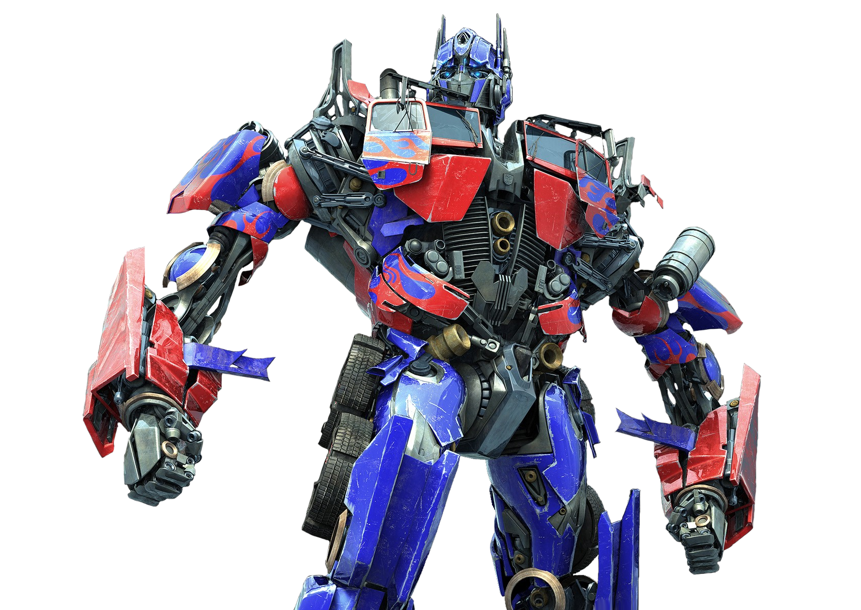
Transformers

Slide 16
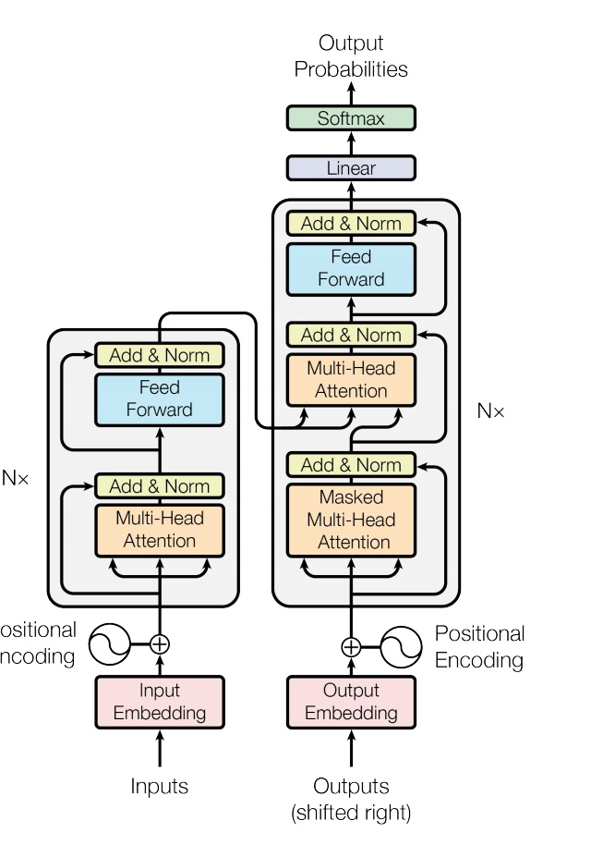
Transformers
Multi-Headed Attention

Slide 17

BERT
BERT's architecture is just a transformer's encoder stack.
It is trained by masking few tokens randomly and outputting masked word using the context.
This will help model to understand the context better.
We can use finetuned BERT (pretrained) for various applications.
It is observed to be quicker.

Slide 18

How we used BERT
We took the pretrained BERT.
We combined premise and hypothesis and padded the sequence.
We also added necessary [CLS], [SEP] tokens at the start and end of sentences.
Took BERT models hidden state and passed it to linear layer.
The output of the linear layer is used to know if they are related, contradictory or neutral.

Slide 19
SpanBERT
Instead of masking random tokens we mask random span of words in this model.
And we try to predict the masked spans through our model.
This helps it to understand the model better.
Representation of adjacent tokens are used to derive masked tokens.

Slide 20

Thats All?

Slide 21
NO!!!!
What will happen if the context it huge?
BERT model only can take upto 512 tokens, so you cannot process whole context at once.
This is only a problem if such application involving huge context exists.
So, does they exist?

Slide 22

Contract NLI
This Photo by Unknown author is licensed under CC BY-SA.

Slide 23
Contract NLI
Given a contract and a set of hypotheses (each being a sentence), to classify whether each hypothesis is entailed by, contradicting to or not mentioned by (neutral to) the contract.
But contract can be huge!!!

Slide 24
What makes this problem interesting?
Reviewing a contract can be tedious and tiresome.
Especially if you have large contracts.
So usually companies hire experts to review contracts.
But this requires lot of resources and time which are not available to small companies.
So they usually skip the process of reviewing the contracts.

Slide 25
What's the solution?
Can we build a completely automated model which would predict if a given clause(or hypothesis as we call it) is Entailed/Contradicted or Not mentioned to the contract.
Such a model would help us automate all these contract reviewing tasks much easier.
Unfortunately the previous models are not good at it :(

Slide 26
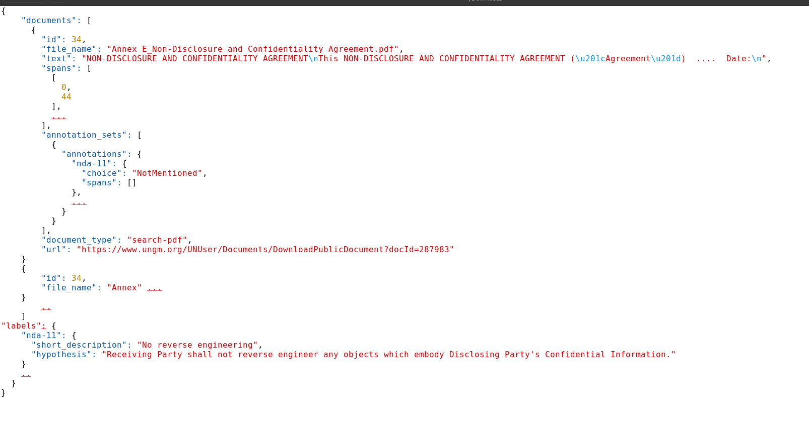
Contract NLI how does it look?

Slide 27

Span NLI BERT (Not SpanBERT :))

Slide 28
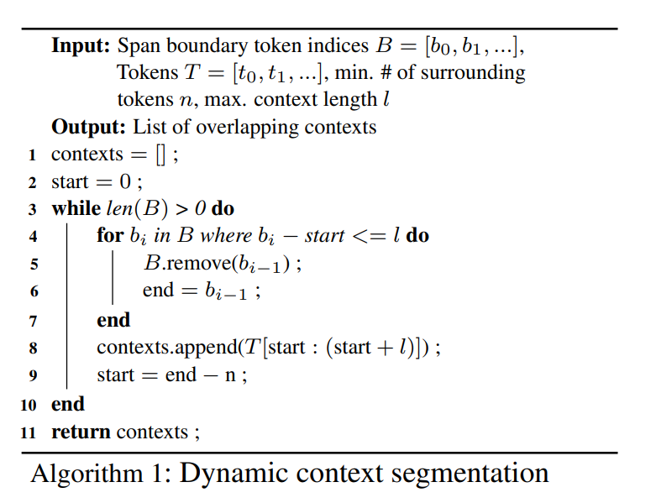
Span NLI BERT
Can we divide contracts into smaller chunks such that each span gets suifficient context in atleast one of the chunks.
Here spans are already given as part of dataset.

Slide 29
Span NLI BERT
Once we get contexts for given contract, we will prepare context, hypothesis pair for each hypothesis similar to way we did in BERT.
Unlike BERT where there was only one linear layer, here we will have two linear layers.
One for evidence, and the other for NLI.

Slide 30
Span BERT NLI
In evidence collection task the main aim is to calculate the [SPAN] probabilities which are part of context.
For this we introduce [SPAN] token before each span. After the model is run we ideally expect it to contain hidden state of the span it belongs.
We will calculate the span probabilites for each [SPAN] token which is part of context.
This is an important step because it will help us identify the evidence for a given context.

Slide 31
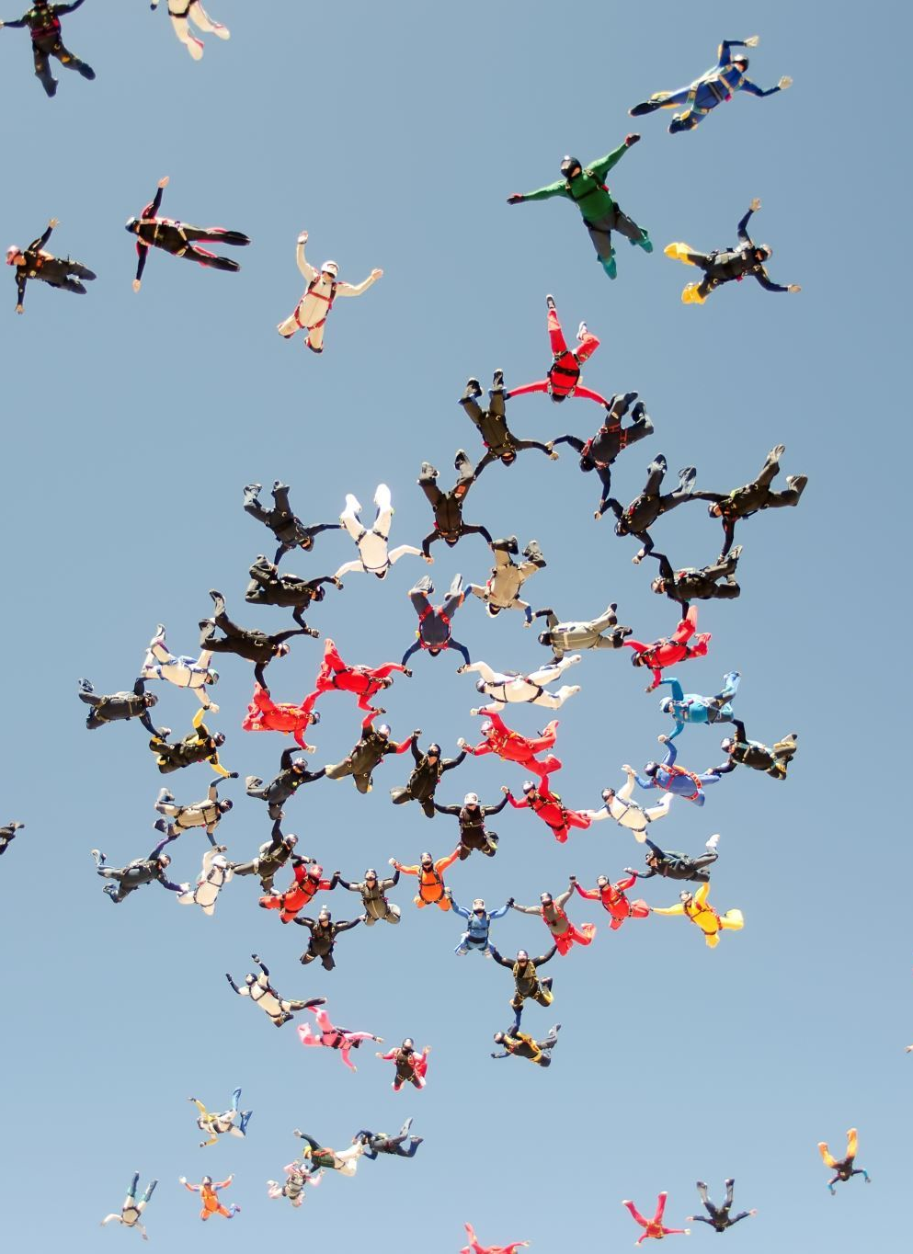
Span NLI BERT
And the second task NLI is similar to ones we performed before.
We just take the last hidden state and categorize it into 3 categories.

Slide 32
Results
Models | SNLI | MultiNLI | ContractNLI
LSTM | 75% | 62% | -
BERT | 86.4% | 80.3% | -
SpanBERT | 88.5% | 82.5% | -
SpanNLIBERT | - | - | 81.6%

Slide 33
Challenges faced
Each computation involves huge amount of computations, so there were constant session crashes. And often we ran out of GPU resources allocated.
We have to dry run the algorithms to understand and write batching algorithms.
There were no standard resource for models, especially contractNLI, for which we read few papers to get an understanding of what the actual algorithm is.
Hyperparameter tuning.
Cleaning datasets, there was no mention that they have some irregularities.

Slide 34

Future Work
There are some research papers which said using RL algorithms along with some representation of spans in terms of graphs which will improve the performance further.
This is out of scope for our project.

Slide 35

Thank You

